Slide 1
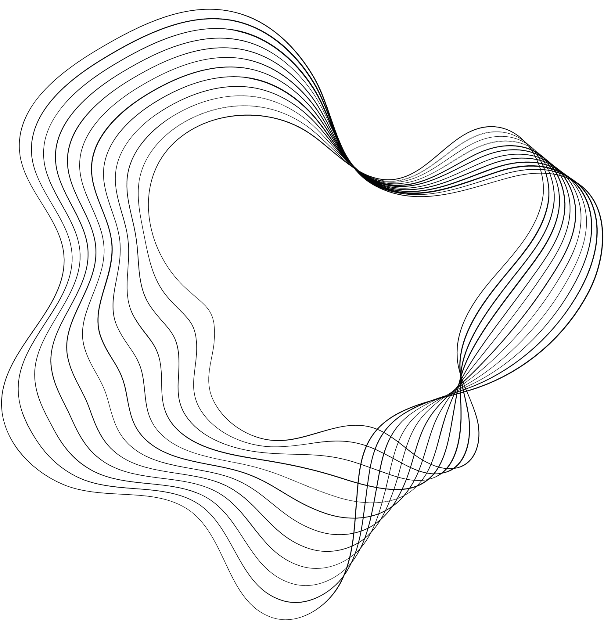



ELECTRICITY CONSUMPTION
PREDICTION
BY: AAKASH JAMWAL

Slide 2

PROBLEM STATEMENT:
This project is focused on leveraging Python for time series prediction of household
electricity consumption. The dataset includes essential features such as date, time, global active power, global reactive power, voltage, global intensity, and sub-metering values. The objective is to build robust time series forecasting models that can accurately predict future electricity consumption trends based on historical data. The insights derived from this analysis can empower households to optimize energy usage, plan efficiently, and contribute to sustainable energy
practices.
OUR GOAL:
The main goal of this project is to leverage Python for time series prediction of household electricity consumption. By analyzing historical data, the project aims to build robust time series forecasting models that can accurately predict future electricity consumption trends. The insights derived from this analysis can help households optimize energy usage, plan efficiently, and contribute to sustainable energy practices.

Slide 3
FEATURES:
1. Date: Date of the electricity consumption recording.
2. Time: Time of the electricity consumption recording.
3. Global_active_power: Total active power consumed by the household.
4. Global_reactive_power: Total reactive power consumed by the household.
5. Voltage: Voltage level during the electricity consumption period.
6. Global_intensity: Total current intensity consumed by the household.
7. Sub_metering_1: Electricity consumption in sub-metering 1 (e.g., kitchen).
8. Sub_metering_2: Electricity consumption in sub-metering 2 (e.g., laundry).
9. Sub_metering_3: Electricity consumption in sub-metering 3 (e.g., water heater).
TARGET VARIABLE:
Global_active_power: Total active power consumed by the household.

Slide 4

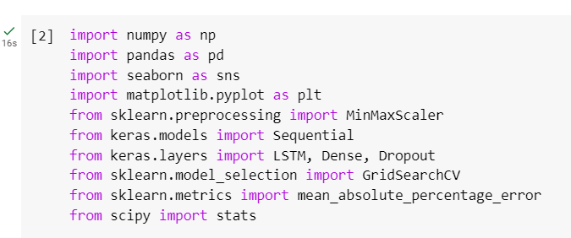
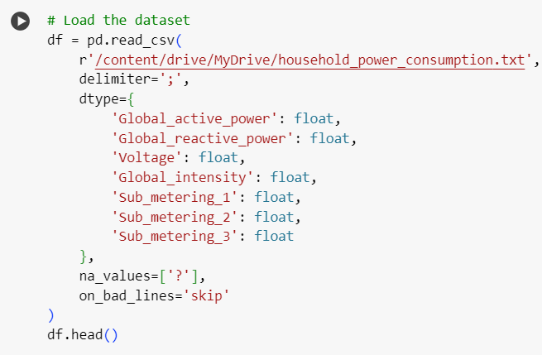
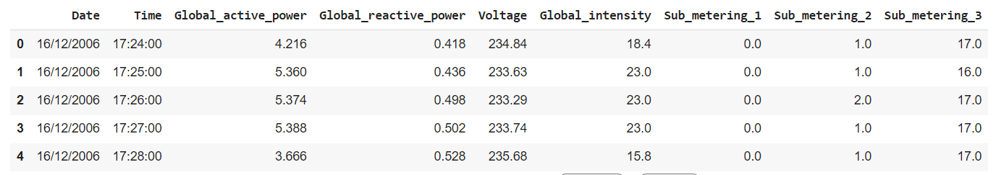
DATA PREPROCESSING:
Imported necessary tools and library and loaded dataset by using pandas. Performed data cleaning activity by Checking missing values, outliers, remove irrelevant column.

Slide 5
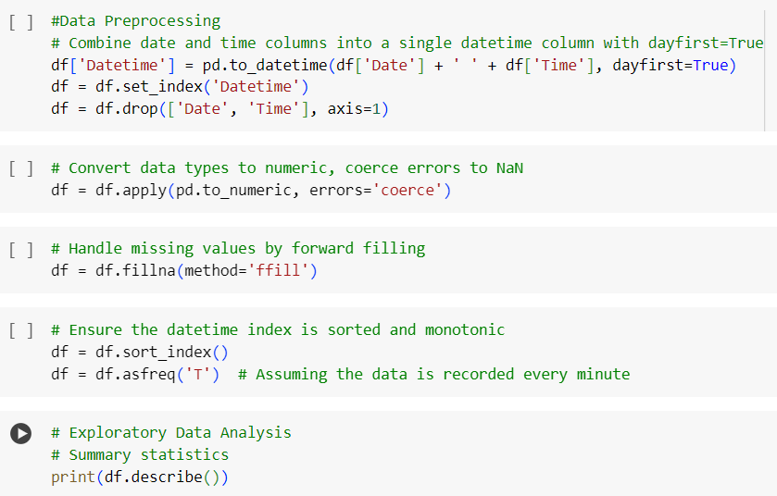
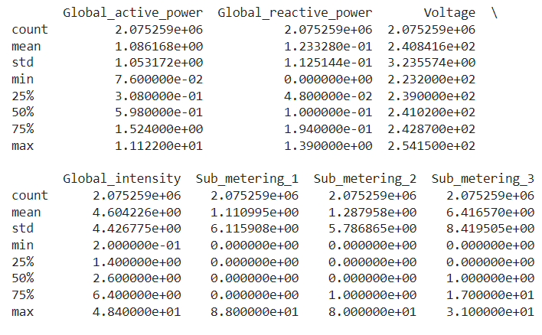

Slide 6
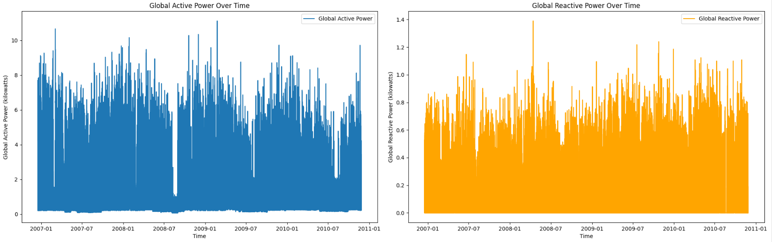
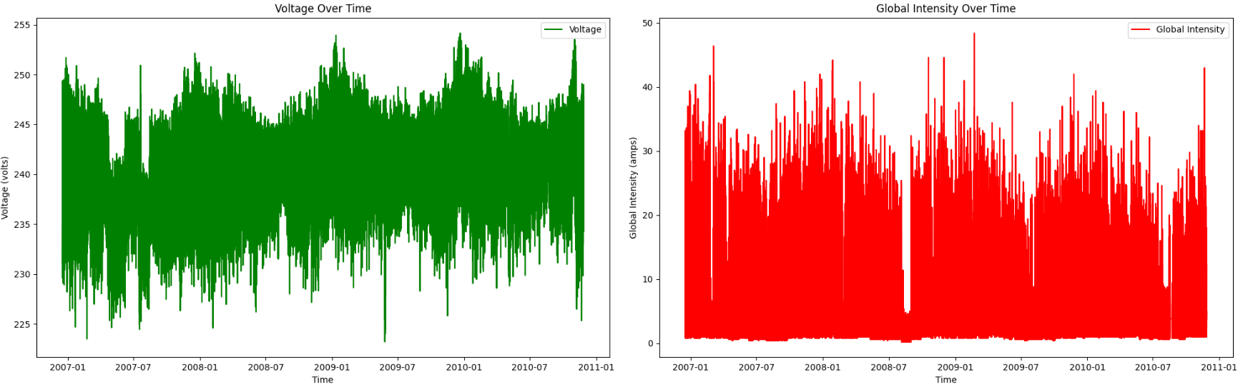
DATA PER MINUTE

Slide 7
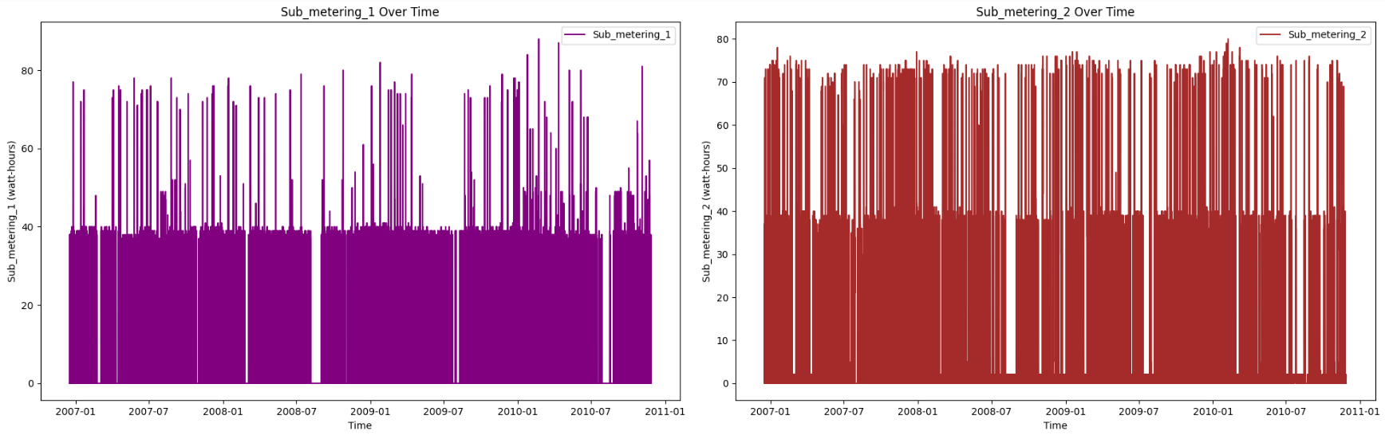
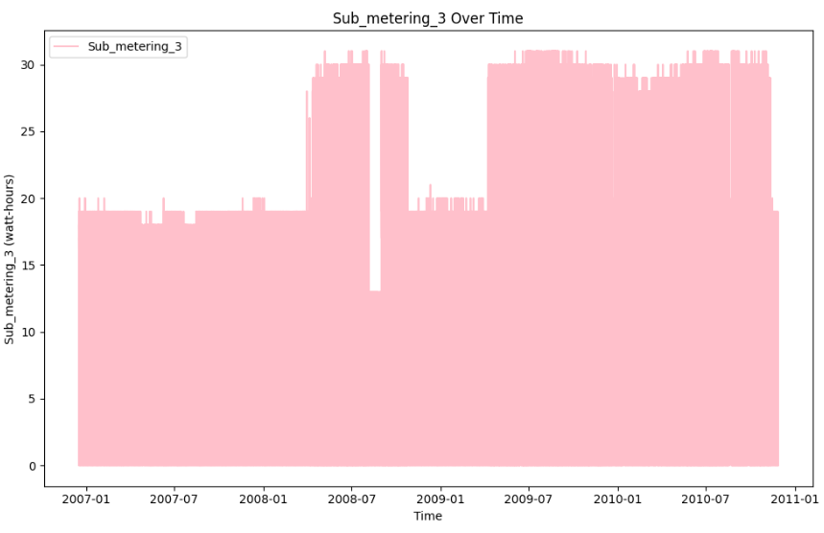
DATA PER MINUTE

Slide 8
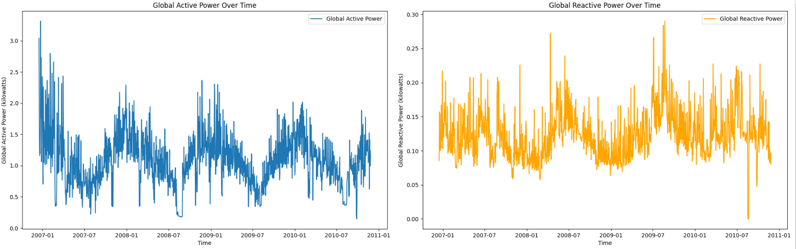
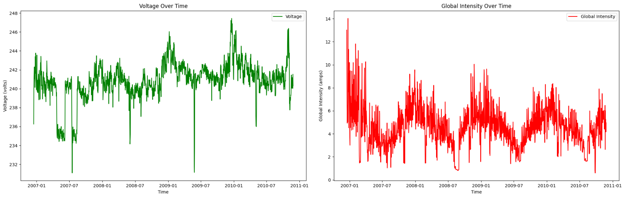
PER MINUTE DATA CONVERTED TO DAY WISE DATA

Slide 9
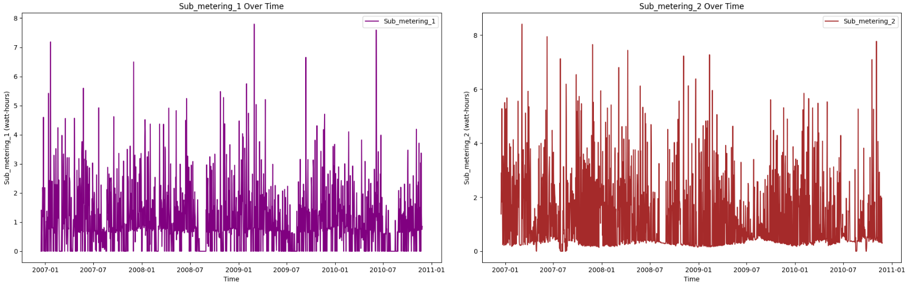
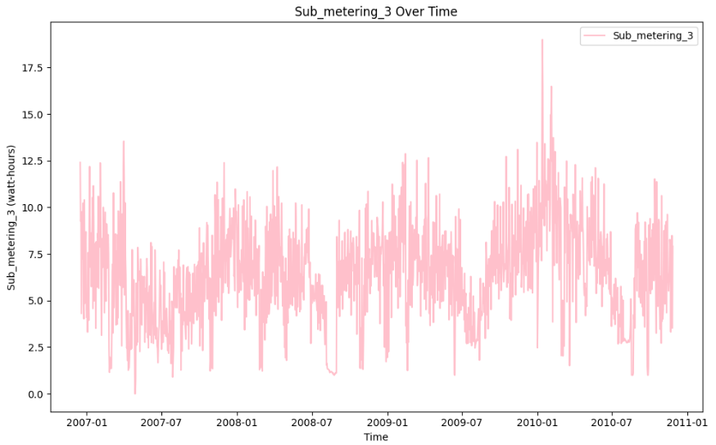
PER MINUTE DATA CONVERTED TO DAY WISE DATA

Slide 10
INSIGHTS
Potential Seasonality: The variations in power usage could indicate seasonality. For example, higher power usage might occur during colder months due to heating or during hotter months due to air conditioning.
Regular Variation: There is a clear pattern of regular variation, which could indicate a daily cycle of power usage, with peaks possibly corresponding to morning or evening when energy usage is typically higher.
Consistent Baseline: A consistent baseline level of power consumption is apparent, indicating a steady usage of electricity that could be associated with always-on devices or a minimum set of appliances regularly used in the household.
Data Gaps: There are some vertical gaps in the data where there appears to be no consumption recorded, or possibly missing data.
Intermittent Drops: There are intermittent drops in power consumption. This could indicate occasional periods when less electricity is used, which may be due to the residents being away, certain appliances not being used, or possible data collection issues.
Recovery After Drops: After the notable drop in power consumption, the levels appear to recover back to the usual range. This suggests that the drop was a temporary event rather than a permanent change in consumption habits or system measurement changes.

Slide 11
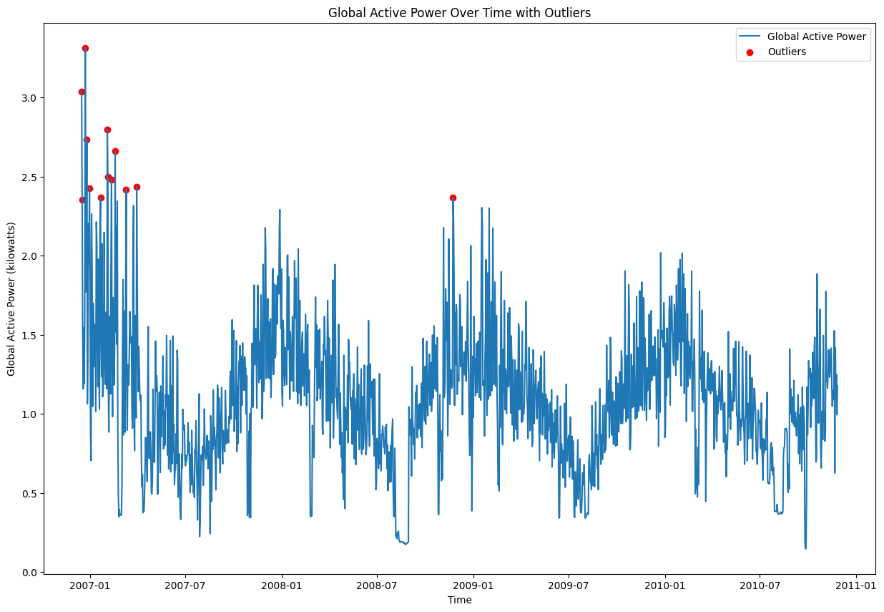

Slide 12
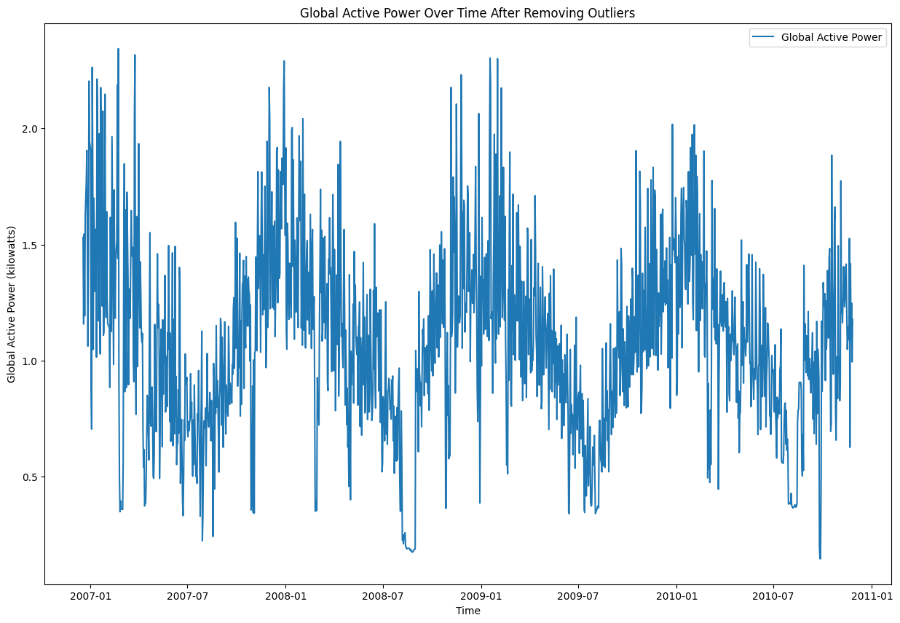

Slide 13
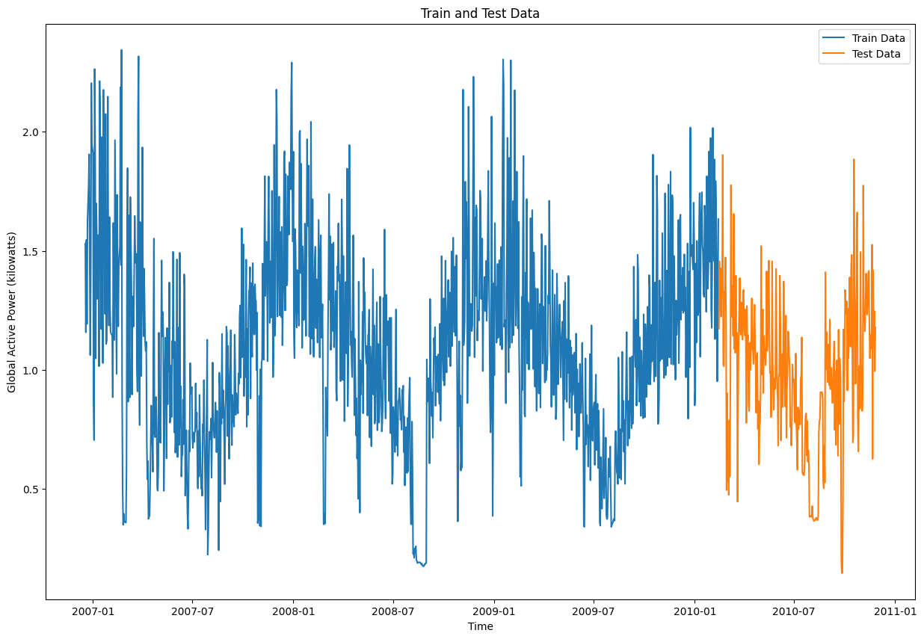
TRAINING AND TESTING SET:

Slide 14
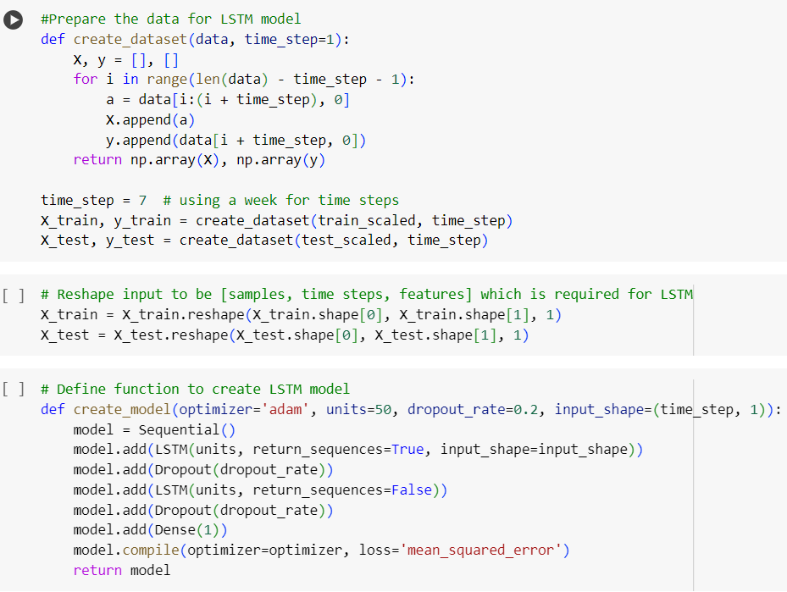
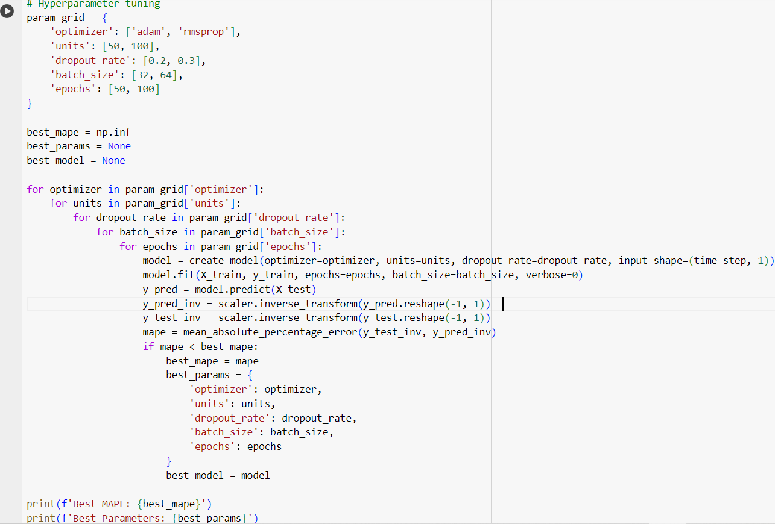
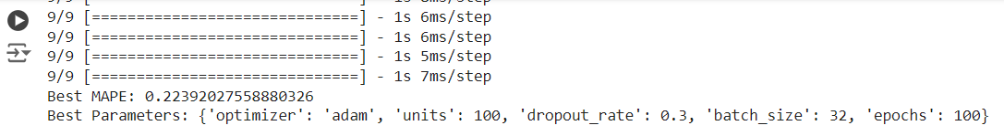

Slide 15
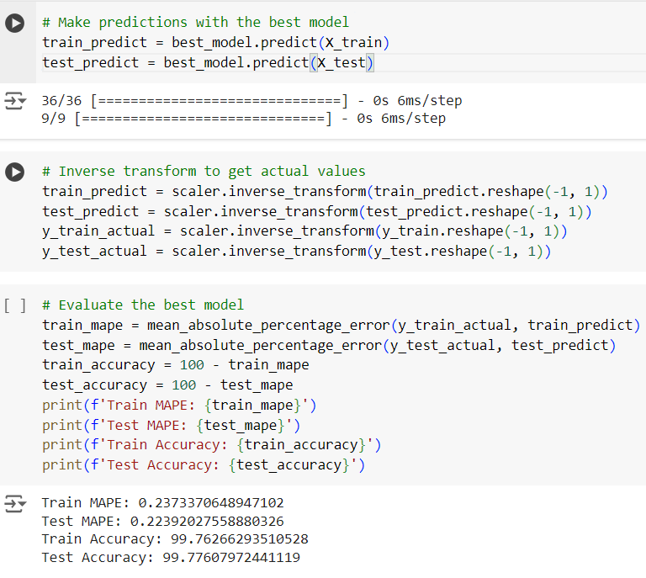
EVALUATING THE MODEL:

Slide 16
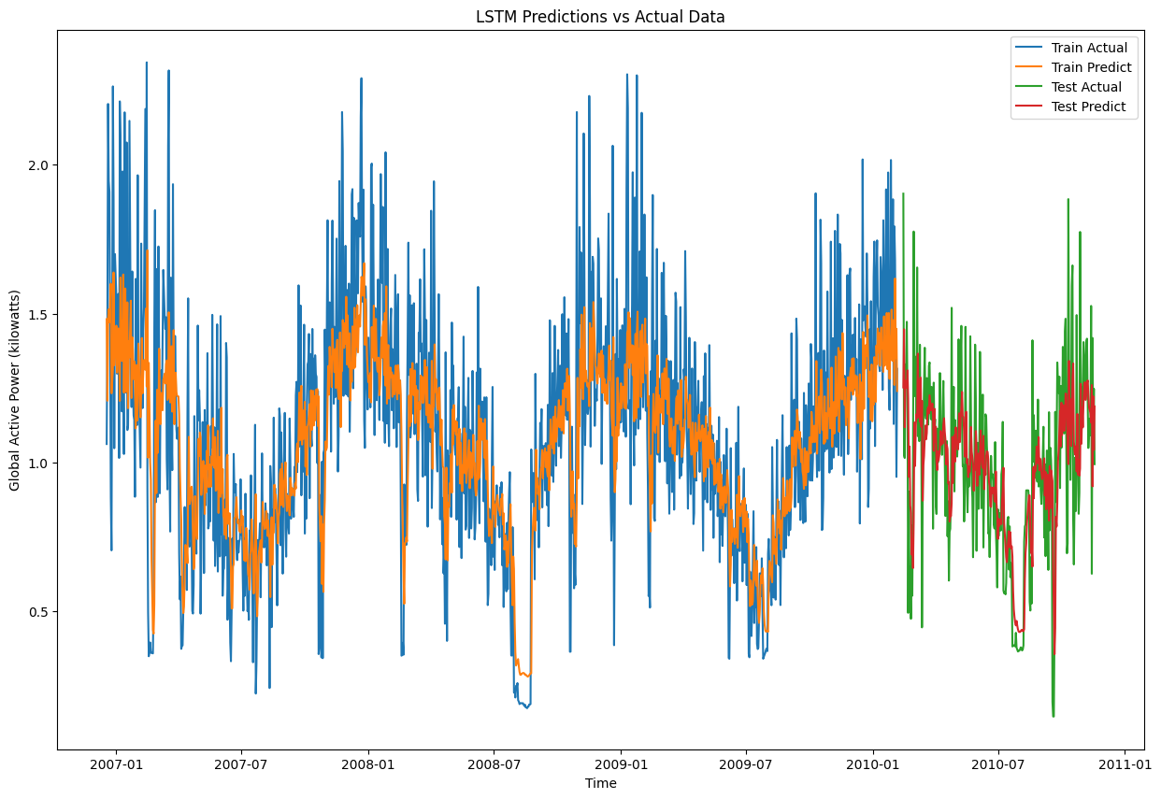
RESULT:

Slide 17

THANK YOU

